Slide 1
Detection of Improvised Explosive Devices using Neutron Activation and Gamma Spectroscopy
HEPH-Hassard-2
22/03/2018
MSci Viva Presentation Slides
Ryan D. Travers
1

Slide 2
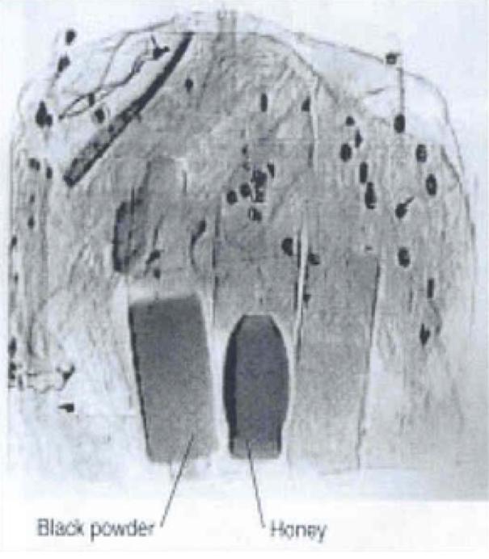
Introduction
HEPH-Hassard-2
22/03/2018
X-ray imaging is commonly at airports and seaports
High processing speeds and ease of operation
Difference in the attenuation used to discriminate between different materials
Impossible to discriminate between plastic explosives and bag of flour [1]
High false positive and negative rates
Hasn’t thwarted a single terrorist plot since their introduction [2]
Is there an alternative technology for the detection of explosives?
2

Slide 3
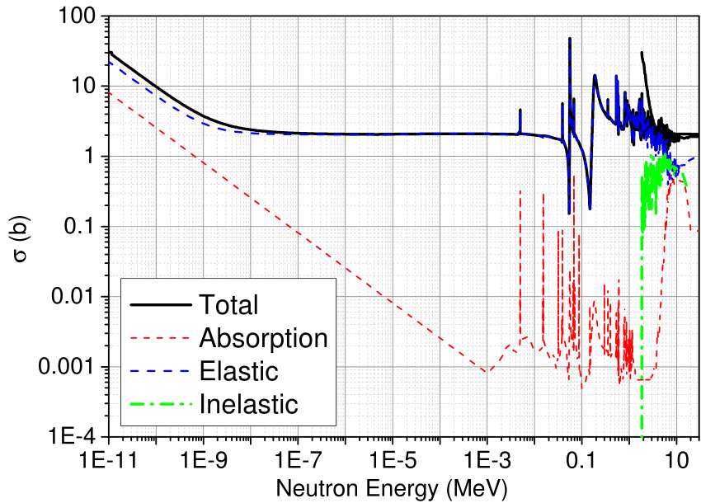
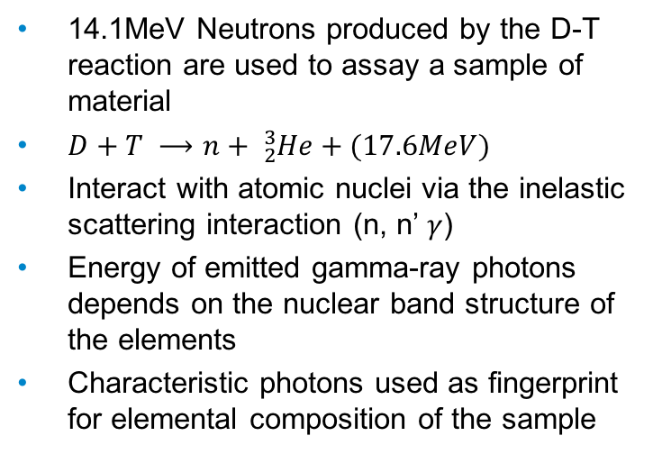
What is Neutron Activation and Gamma Spectroscopy?
HEPH-Hassard-2
22/03/2018
Si-28 Neutron Cross Sections [3]
14.1MeV Neutrons produced by the D-T reaction are used to assay a sample of material
$D+T ⟶n+ {}_{2}^{3}{He+(17.6MeV)}$
Interact with atomic nuclei via the inelastic scattering interaction (n, n’ $γ$)
Energy of emitted gamma-ray photons depends on the nuclear band structure of the elements
Characteristic photons used as fingerprint for elemental composition of the sample
3

Slide 4
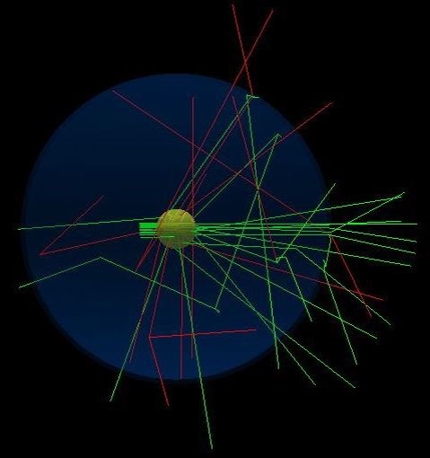
Geant4 Simulations
HEPH-Hassard-2
23/03/2018
Gean4 is a toolkit for the passage of particles through matter using Monte Carlo Methods
Handles geometry of the detection environment, tracking of particles and response of particle detectors
Spherical sample at the origin
4𝛑 spherical shell detector
Simulations initialised with collimated beam of 50 or 100 million 14MeV neutrons fired towards sample
Detector
Neutron beam
Sample
4

Slide 5
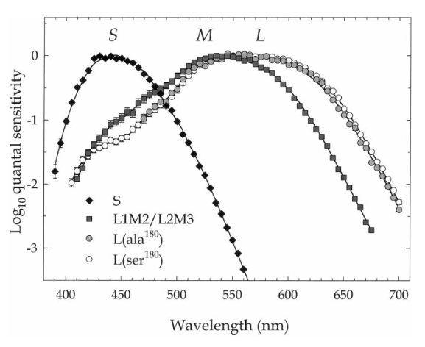
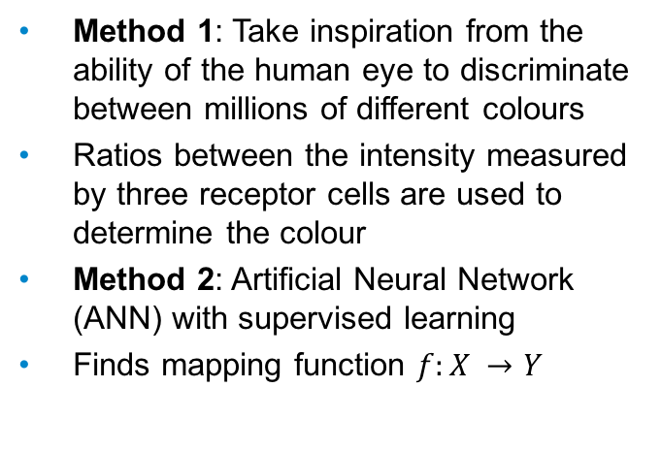
Two Methods for Determining the Elemental Composition
HEPH-Hassard-2
22/03/2018
Sensitivity of human cone cells [4]
Method 1: Take inspiration from the ability of the human eye to discriminate between millions of different colours
Ratios between the intensity measured by three receptor cells are used to determine the colour
Method 2: Artificial Neural Network (ANN) with supervised learning
Finds mapping function $f:X →Y$
5

Slide 6
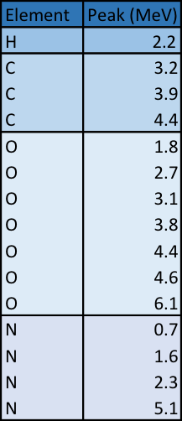
Method 1: The Spectrum Filter Approach
HEPH-Hassard-2
22/03/2018
Use spectrum filters to alter the response function of gamma-ray detectors
Different transmission coefficients as a function of photon energy
Ratio between the intensity of radiation measured by each detector used for energy discrimination
Do such spectrum filters exist in the MeV range?
6

Slide 7
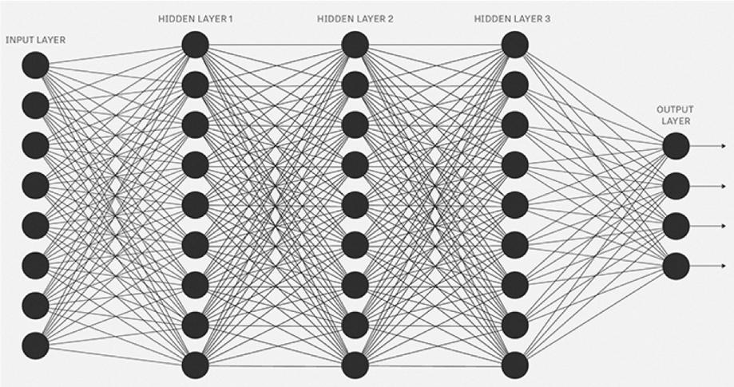
HEPH-Hassard-2
22/03/2018
Method 2: Machine Learning Approach
Artificial Neural Network with supervised learning
Training and prediction phase
Multi-channel pulse height analysers split spectrum into energy bins
Limit on resolution is 1keV
Maps the photon counts onto the elemental compositions
Input: photon counts
of N^{th} energy bin
1
2
3
.
.
.
N-1
N
H (%)
C (%)
N (%)
O (%)
7

Slide 8
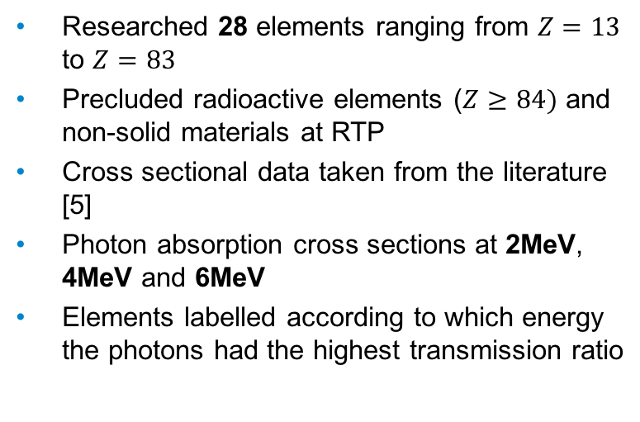
Results 1: Spectrum Filters Approach
HEPH-Hassard-2
22/03/2018
Researched 28 elements ranging from $Z=13$ to $Z=83$
Precluded radioactive elements ($Z≥84)$ and non-solid materials at RTP
Cross sectional data taken from the literature [5]
Photon absorption cross sections at 2MeV, 4MeV and 6MeV
Elements labelled according to which energy the photons had the highest transmission ratio
8

Slide 9
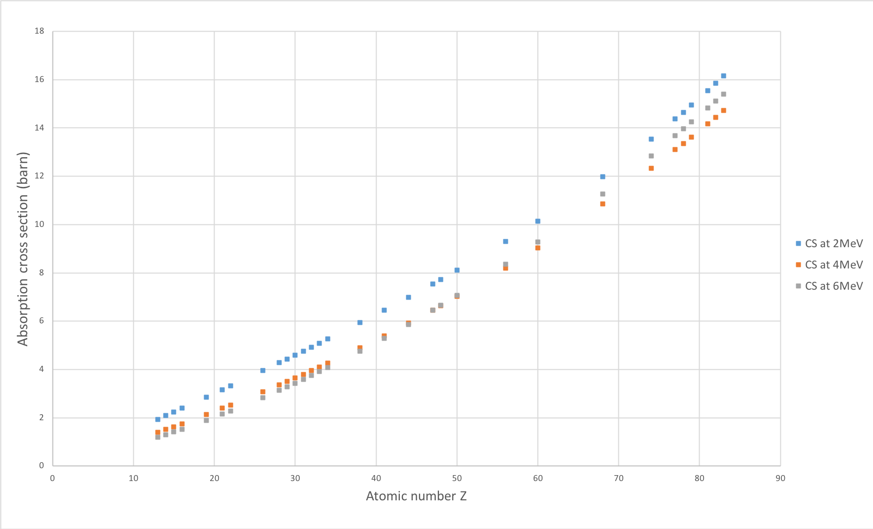
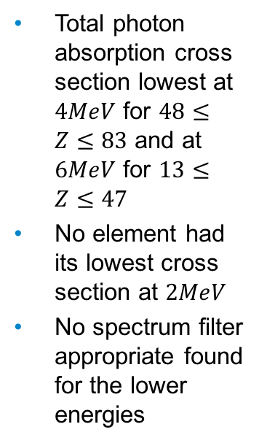
HEPH-Hassard-2
22/03/2018
Total photon absorption cross section lowest at $4MeV$ for $48≤Z≤83$ and at $6MeV$ for $13≤Z≤47$
No element had its lowest cross section at $2MeV$
No spectrum filter appropriate found for the lower energies
9

Slide 10
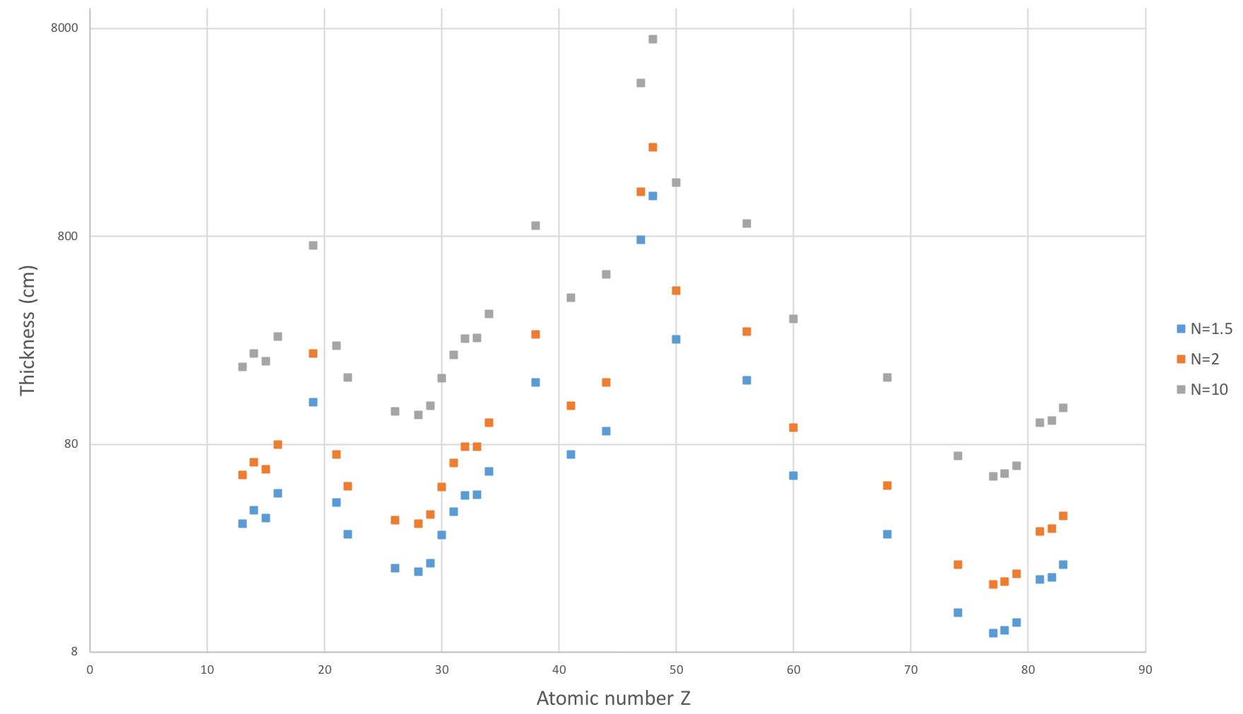
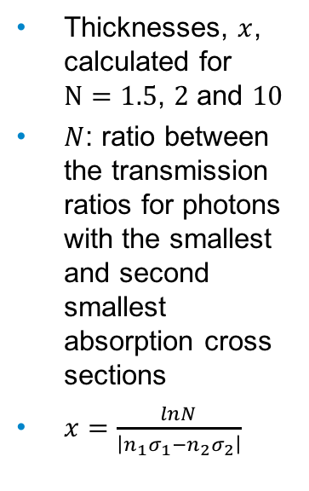
HEPH-Hassard-2
22/03/2018
Thicknesses, $x$, calculated for $N=1.5$, $2$ and $10$
$N$: ratio between the transmission ratios for photons with the smallest and second smallest absorption cross sections
$x=\frac{lnN}{\left|n_{1}σ_{1}−n_{2}σ_{2}\right|}$
10

Slide 11
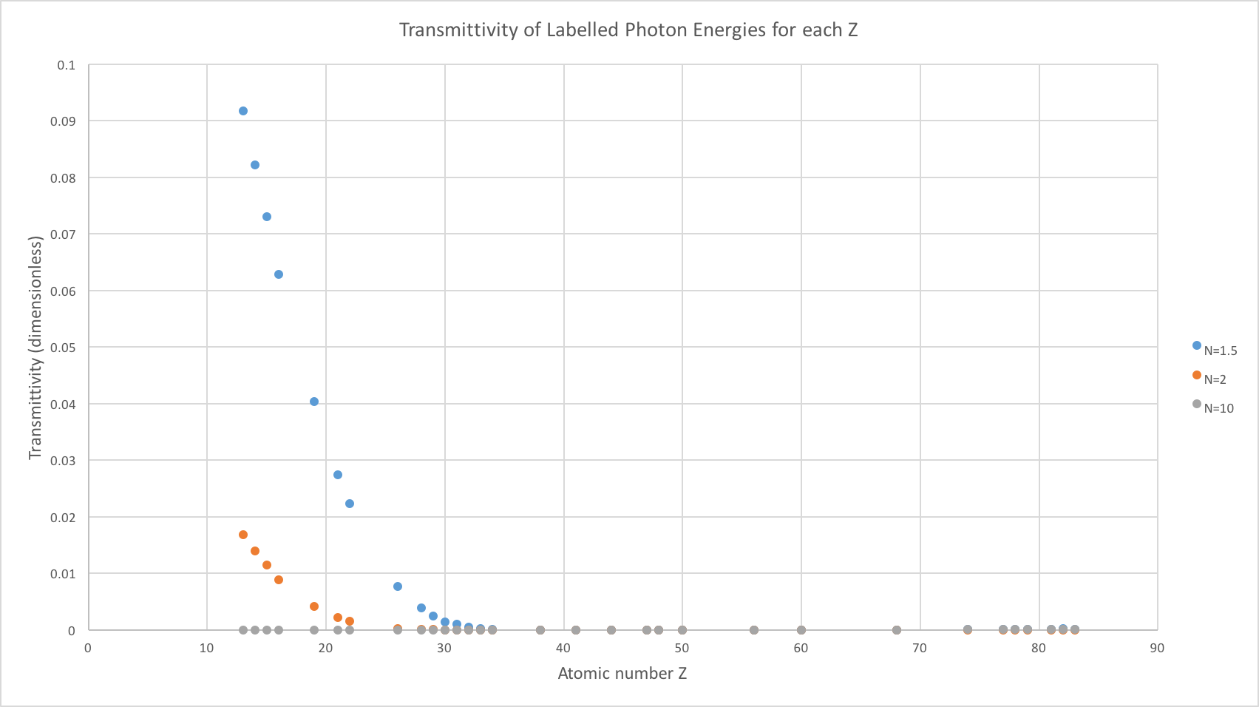
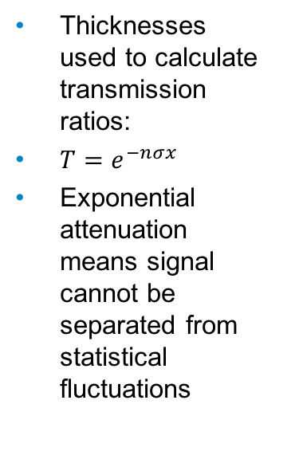
Attenuations | N=1.5 | N=2
Z=13 (Al) | 9.2E-2 | 1.7E-2
Z=82 (Pb) | 1.6E-4 | 3.3E-7
HEPH-Hassard-2
22/03/2018
Thicknesses used to calculate transmission ratios:
$T=e^{−nσx}$
Exponential attenuation means signal cannot be separated from statistical fluctuations
11

Slide 12
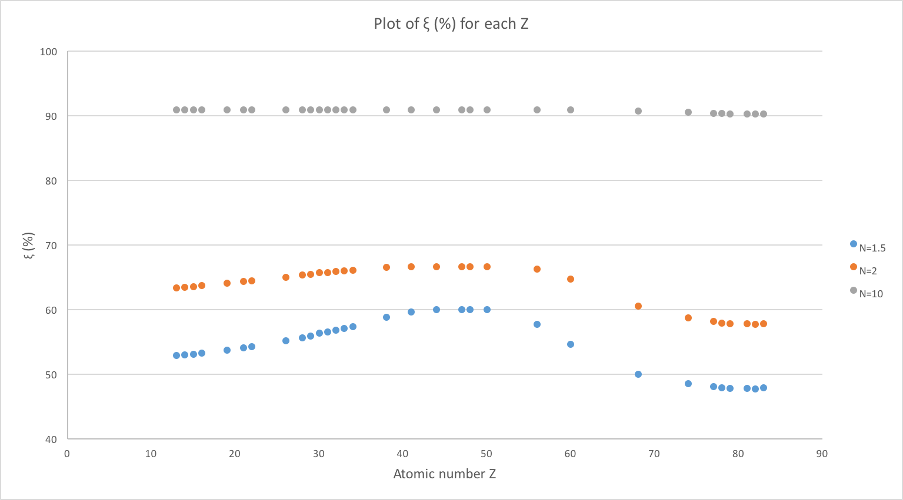
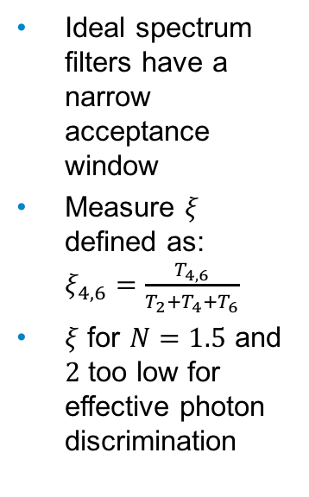
HEPH-Hassard-2
22/03/2018
Ideal spectrum filters have a narrow acceptance window
Measure $ξ$ defined as: $ξ_{4,6}=\frac{T_{4,6}}{T_{2}+T_{4}+T_{6}}$
$ξ$ for $N=1.5$ and $2$ too low for effective photon discrimination
12

Slide 13
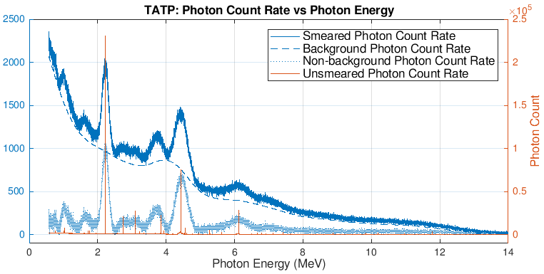
Results 2: Machine Learning Approach
HEPH-Hassard-2
22/03/2018
Simulations in Geant4 to produce gamma-ray spectra for BGO and HPGe detectors
Gaussian smearing to model detector response function
Asymmetric least squares method for baseline subtraction
65 permutations covering 4D space of H, C, N and O
Predictive capabilities of the ANN tested with 10 explosives and 10 benign materials
False positives and negatives have been calculated for each detector
13

Slide 14
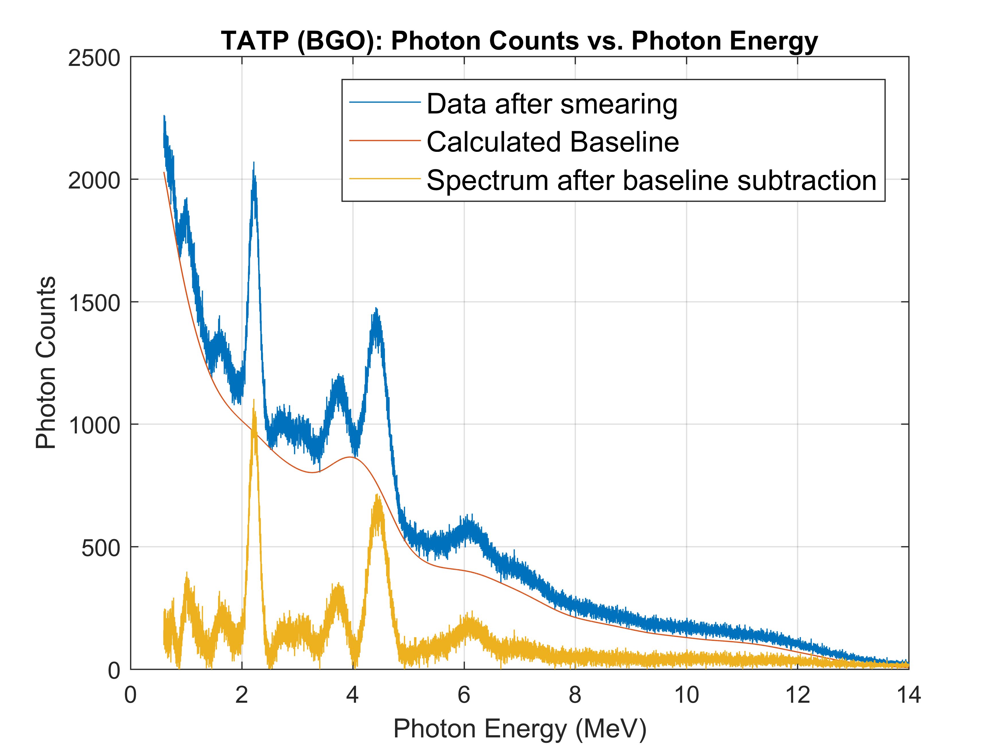
Results 2: BGO
HEPH-Hassard-2
22/03/2018
Constant resolution of 10% taken from experimental data [6]
Unable to resolve some characteristic gamma-ray peaks
No resolvable Hydrogen peak effected accuracy of predictions
Photon counts split into bins of 20keV from 0.6MeV to 14MeV and inputted into ANN
14

Slide 15
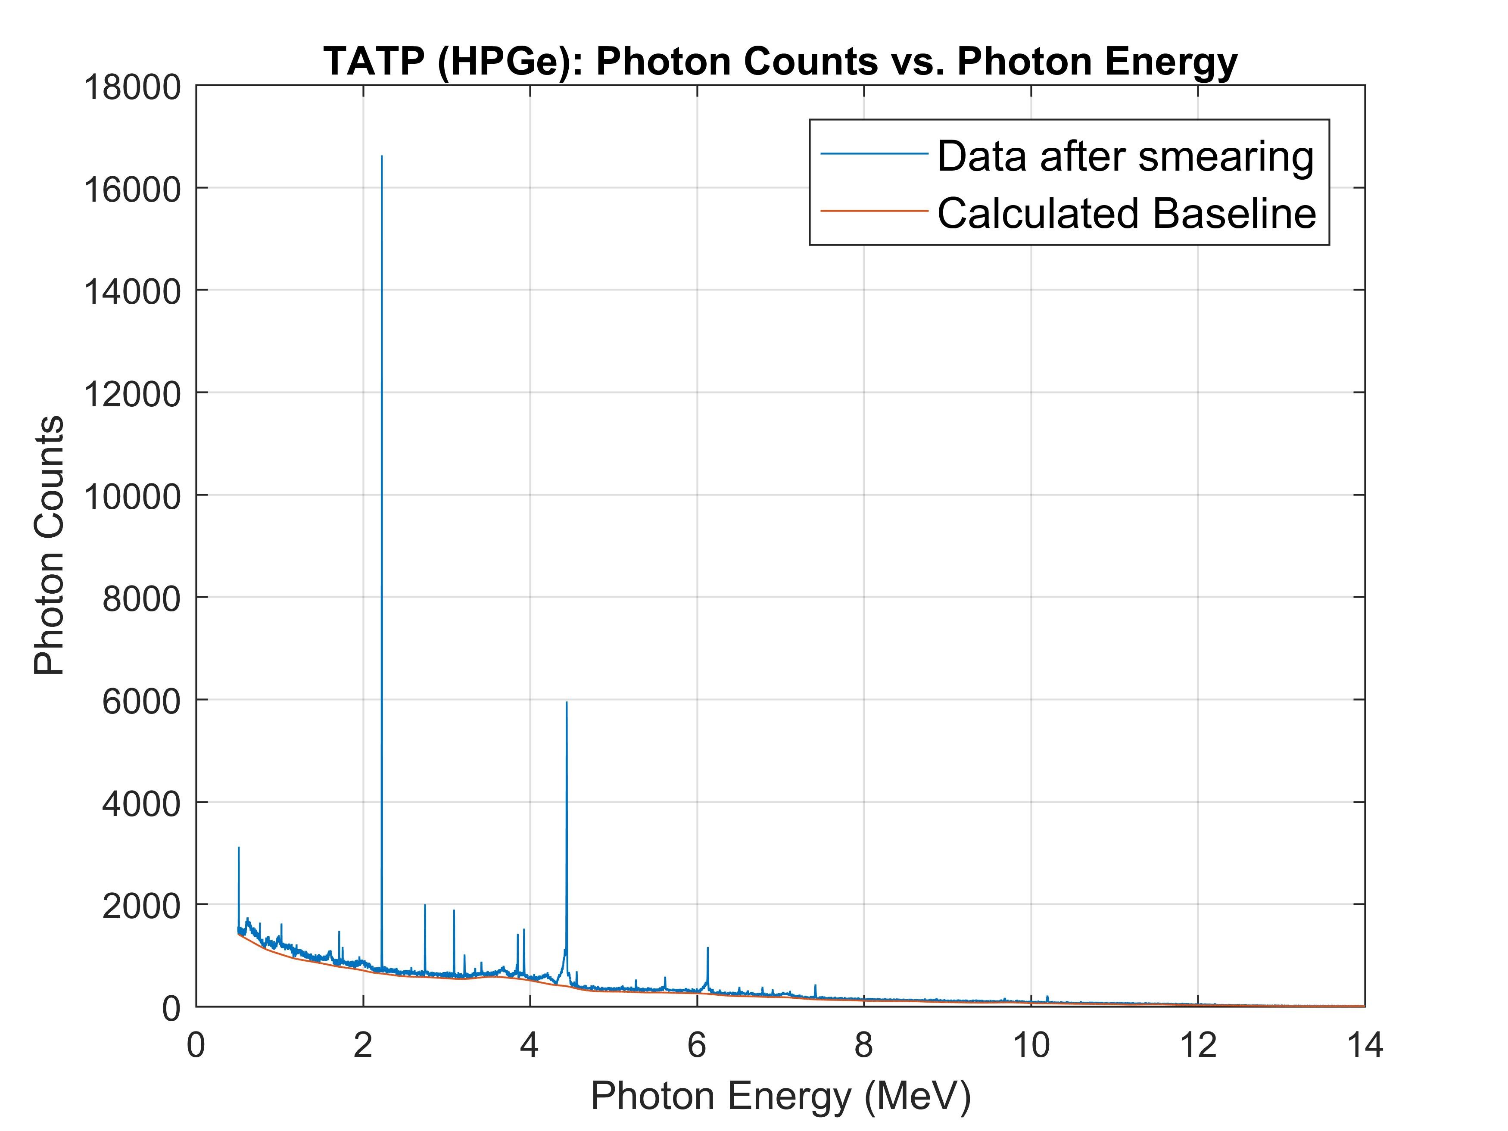
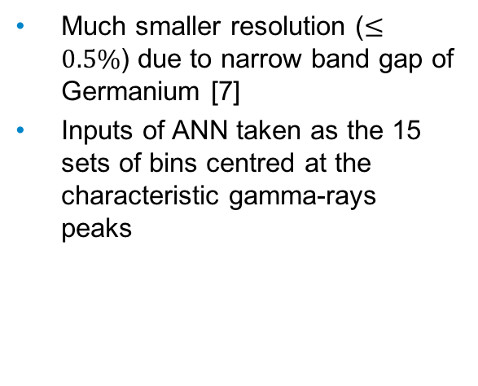
Result 2: HPGe
HEPH-Hassard-2
22/03/2018
Much smaller resolution ($≤0.5\%$) due to narrow band gap of Germanium [7]
Inputs of ANN taken as the 15 sets of bins centred at the characteristic gamma-rays peaks
15

Slide 16
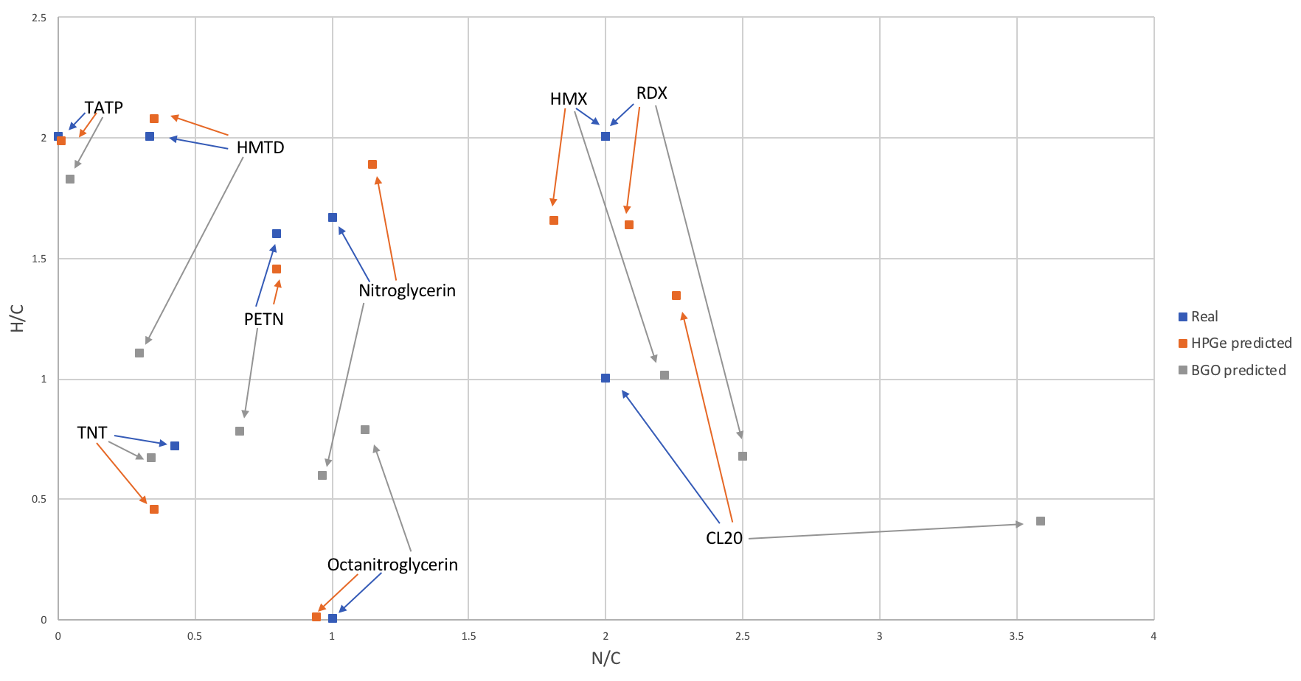
ANN Predictions with BGO and HPGe
HEPH-Hassard-2
22/03/2018
16

Slide 17
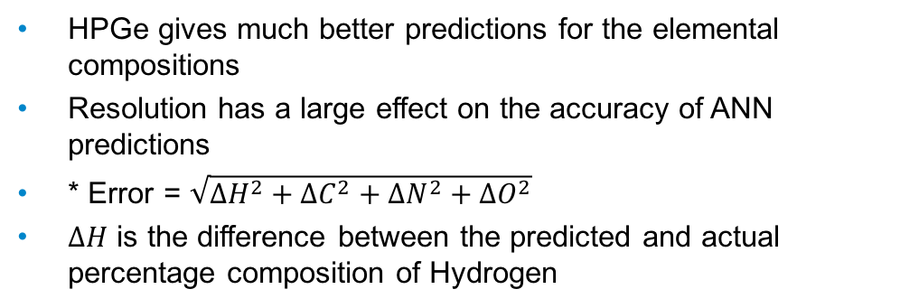
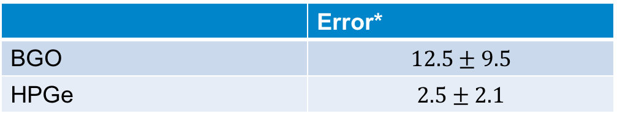
Results 2: Predictive capabilities of the ANN
HEPH-Hassard-2
22/03/2018
 | Error*
BGO | $$12.5±9.5$$
HPGe | $$2.5±2.1$$
HPGe gives much better predictions for the elemental compositions
Resolution has a large effect on the accuracy of ANN predictions
* Error = $\sqrt{{∆H}^{2}+{∆C}^{2}+{∆N}^{2}+{∆O}^{2}}$
$∆H$ is the difference between the predicted and actual percentage composition of Hydrogen
17

Slide 18
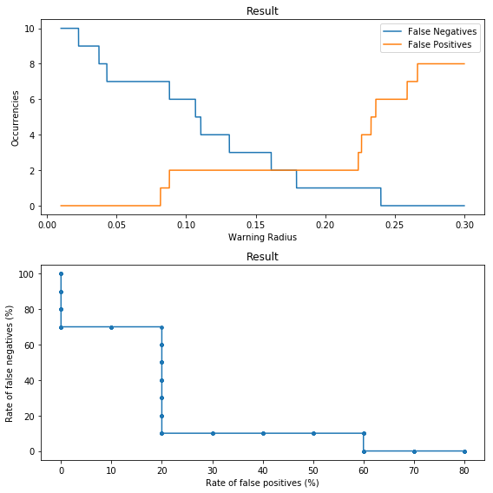
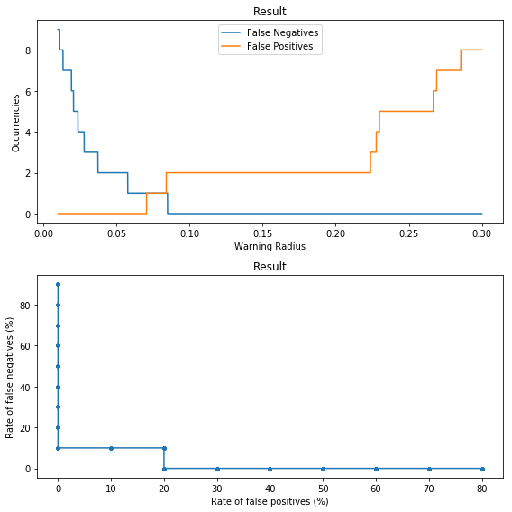
False negative and positive detection rates calculated for BGO (left) and HPGe (right) as a function of warning radius
HEPH-Hassard-2
22/03/2018
18

Slide 19
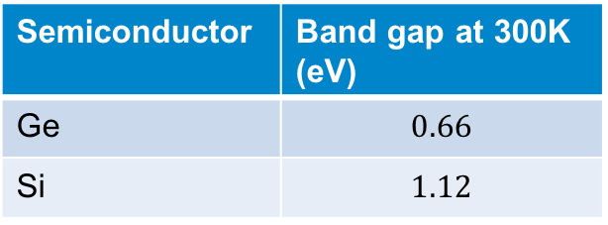
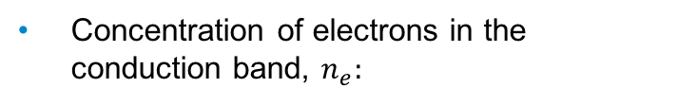
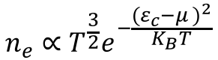
Practical Challenges
HEPH-Hassard-2
22/03/2018
HPGe kept at 77K to prevent thermal excitation of electrons from the valence to conduction band
Constant supply of liquid Nitrogen coolant
Neutrons are highly penetrative and so lots of shielding needed
More research into the average processing time for each scan
Can the costs of the detection system be justified?
Semiconductor | Band gap at 300K (eV)
Ge | $$0.66$$
Si | $$1.12$$
Concentration of electrons in the conduction band, $n_{e}:$
$$n_{e}∝T^{\frac{3}{2}}e^{−\frac{{(ε_{c}−μ )}^{2}}{K_{B}T}}$$
19

Slide 20
Bibliography
HEPH-Hassard-2
22/03/2018
[1] Zentai, G. (2008). X-ray imaging for homeland security. Imaging Systems and Techniques, 2008. IST 2008. IEEE International Workshop on, 1-6.
[2] Khan, F. N. (2017). Is That Airport Security Scanner Really Safe? Scientific American. [online]. Available from: https://blogs.scientificamerican.com/observations/is-that-airport-security-scanner-really-safe/ [Accessed 20/03/2018].
[3] Hodgson, Lohstroh, Sellin, & Thomas. (2017). Neutron detection performance of silicon carbide and diamond detectors with incomplete charge collection properties. Nuclear Inst. and Methods in Physics Research, A, 847, 1-9.
[4] Stockman, A. & Sharpe, L. Human cone spectral sensitivities: a progress report. Vision Research, 1998, Vol.38(21), pp.3193-3206.
[5] Hubbell, J., Gimm, et al. (1980). Pair, Triplet, and Total Atomic Cross Sections (and Mass Attenuation Coefficients) for 1 MeV‐100 GeV Photons in Elements Z =1 to 100. Journal of Physical and Chemical Reference Data, 9(4), 1023-1148.
[6] S. Lam, M. Gascón, S. Podowitz, S. Curtarolo and R. S. Feigelson, "Nonproportionality and Scintillation Responses of LSO:Ce From 4.3 to 300 K," in IEEE Transactions on Nuclear Science, vol. 60, no. 2, pp. 993-999, April 2013.
[7] Calligaris, L., Massironi, A. & Presotto, L. (2006/2007). Gamma Spectroscopy. Available at: http://virgilio.mib.infn.it/labdida/lib/exe/fetch.php?id=laboratorio_di_fisica_delle_particelle&cache=cache&media=relazionelaboratoriogamma.pdf [Accessed 21/03/2018].
[8] (2006). Gamma Interactions: Photoelectric Effect and Pair Production. Lecture notes in Applied Nuclear Physics, MIT. [online] Available from: https://ocw.mit.edu/courses/nuclear-engineering/22-101-applied-nuclear-physics-fall-2006/lecture-notes/lec20.pdf [Accessed 21/03/2018].
[9] Compton Scattering. Lecture delivered on 25th October 2006. Available at: http://lappweb.in2p3.fr/~maire/tutorials/compton.pdf [Accessed 21/03/2018].
20

Slide 21
Appendix
HEPH-Hassard-2
22/03/2018
21

Slide 22
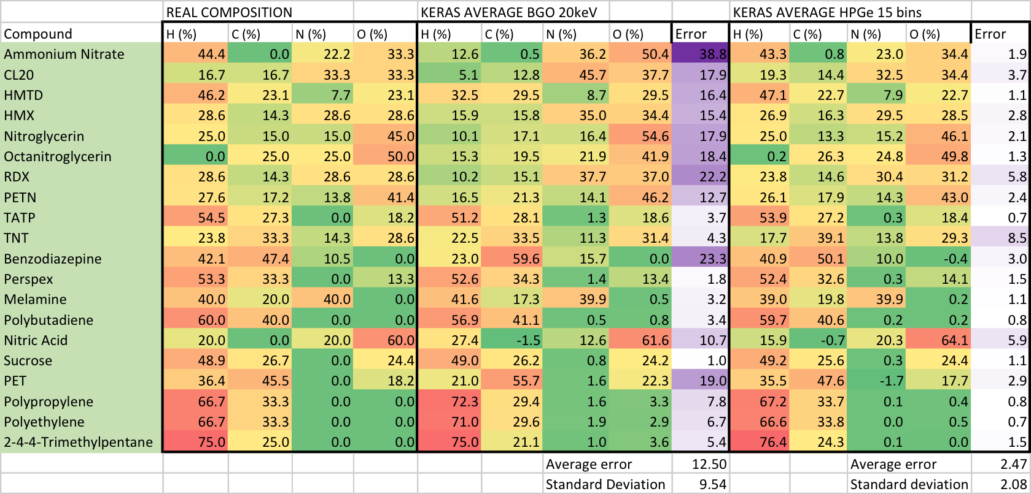
Results 2: Raw Predictions Data
HEPH-Hassard-2
22/03/2018
22

Slide 23
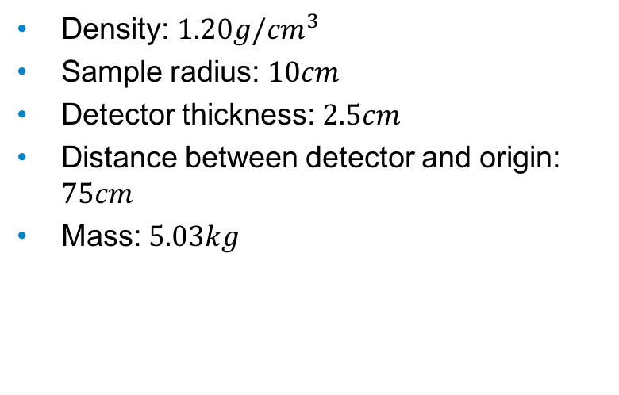
Appendix: Geant4 Environment
HEPH-Hassard-2
22/03/2018
Density: $1.20g/{cm}^{3}$
Sample radius: $10cm$
Detector thickness: $2.5cm$
Distance between detector and origin: $75cm$
Mass: $5.03kg$
23

Slide 24
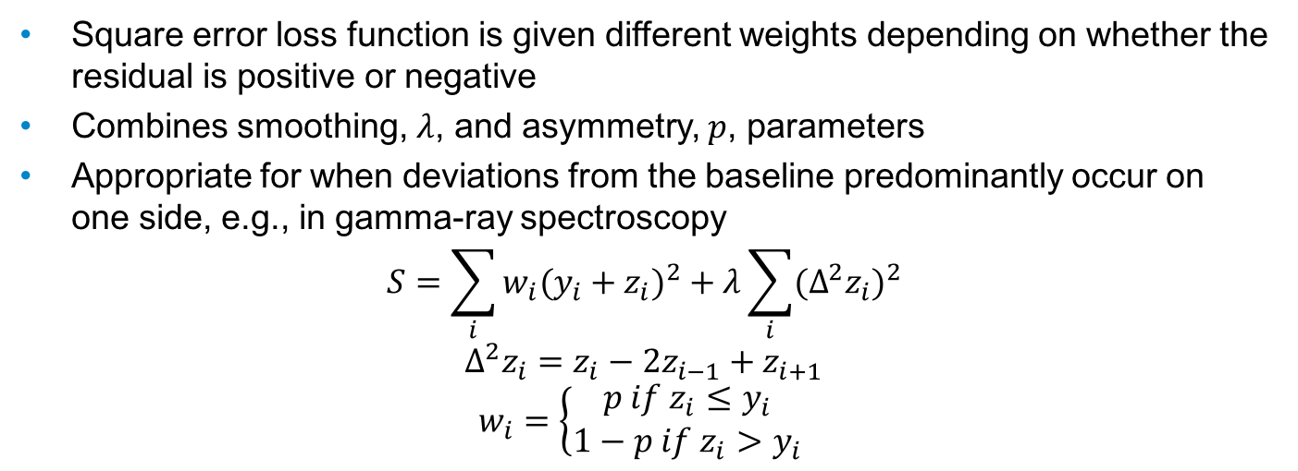
Baseline Correction: Asymmetric Least Square Method
HEPH-Hassard-2
22/03/2018
Square error loss function is given different weights depending on whether the residual is positive or negative
Combines smoothing, $λ$, and asymmetry, $p$, parameters
Appropriate for when deviations from the baseline predominantly occur on one side, e.g., in gamma-ray spectroscopy
$$S=\sum_{i}{w_{i}{(y_{i}+z_{i})}^{2}}+λ\sum_{i}{{(Δ^{2}z_{i})}^{2}}$$
$$Δ^{2}z_{i}=z_{i}−2z_{i−1}+z_{i+1}$$
$$w_{i}=\left\{\begin{aligned}p if z_{i}≤y_{i} \\ 1−p if z_{i}>y_{i}\end{aligned} \right.$$
24

Slide 25
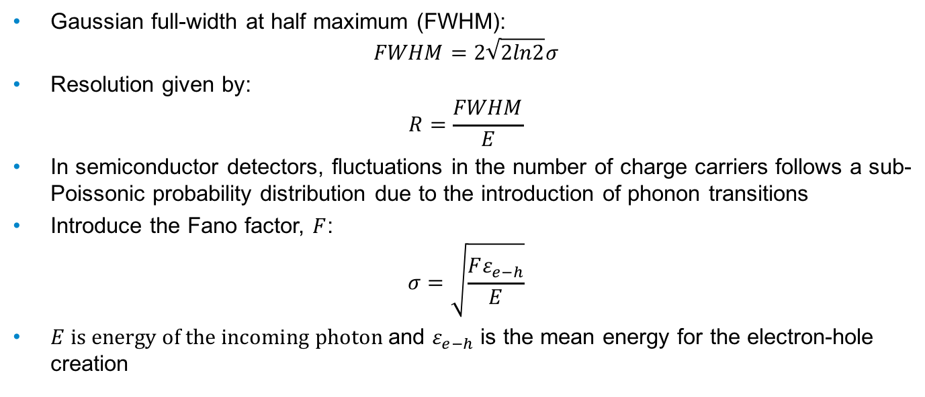
Detector Response: Resolution
HEPH-Hassard-2
22/03/2018
Gaussian full-width at half maximum (FWHM):
$$FWHM=2\sqrt{2ln2}σ$$
Resolution given by:
$$R=\frac{FWHM}{E}$$
In semiconductor detectors, fluctuations in the number of charge carriers follows a sub-Poissonic probability distribution due to the introduction of phonon transitions
Introduce the Fano factor, $F$:
$$σ=\sqrt{\frac{Fε_{e−h}}{E}}$$
$E is energy of the incoming photon$and $ε_{e−h}$ is the mean energy for the electron-hole creation
25

Slide 26
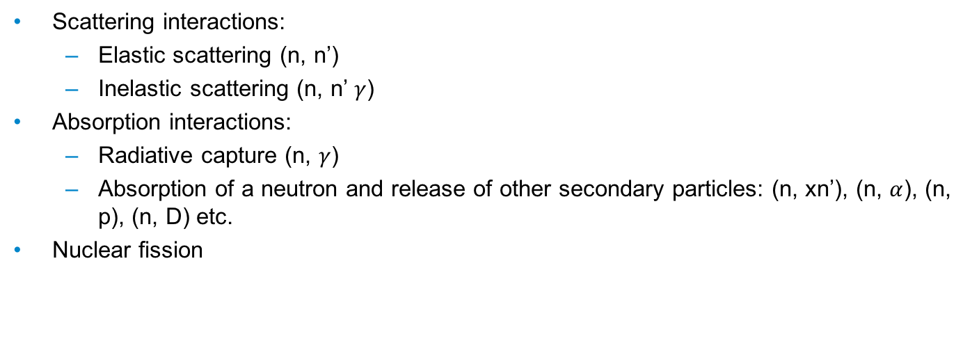
Neutron Interactions:
HEPH-Hassard-2
22/03/2018
Scattering interactions:
Elastic scattering (n, n’)
Inelastic scattering (n, n’ $γ$)
Absorption interactions:
Radiative capture (n, $γ$)
Absorption of a neutron and release of other secondary particles: (n, xn’), (n, $α$), (n, p), (n, D) etc.
Nuclear fission
26

Slide 27
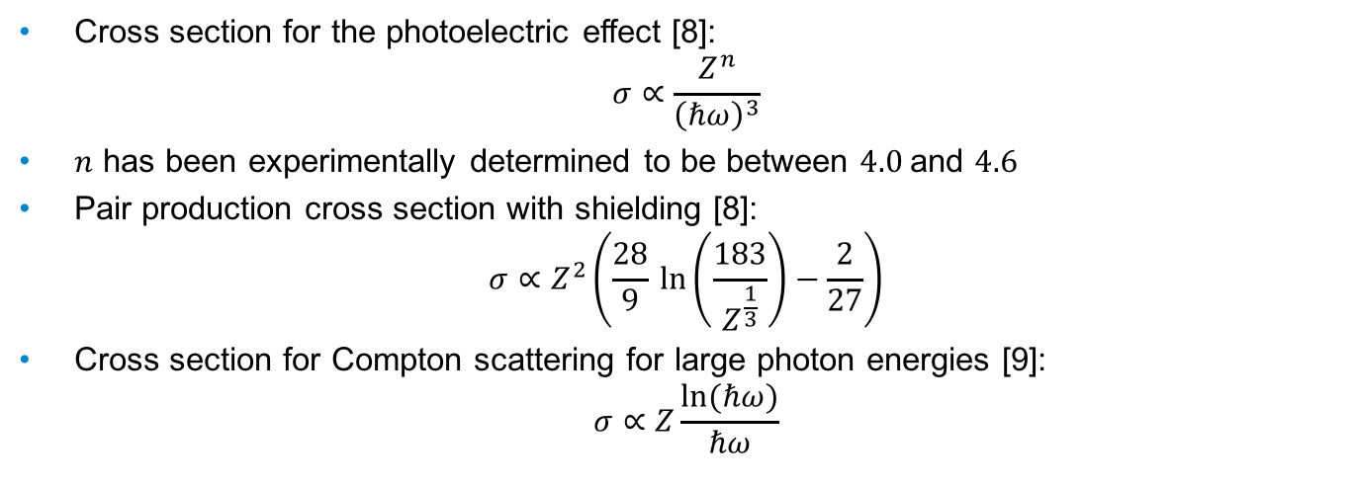
Cross sections for photon interactions
HEPH-Hassard-2
22/03/2018
Cross section for the photoelectric effect [8]:
$$σ∝\frac{Z^{n}}{{\left(ℏω\right)}^{3}}$$
$n$ has been experimentally determined to be between $4.0$and $4.6$
Pair production cross section with shielding [8]:
$$σ∝Z^{2}\left(\frac{28}{9}⁡\ln\left(\frac{183}{Z^{\frac{1}{3}}}\right)−\frac{2}{27}\right)$$
Cross section for Compton scattering for large photon energies [9]:
$$σ∝Z\frac{ln⁡(ℏω)}{ℏω}$$
27

Slide 28
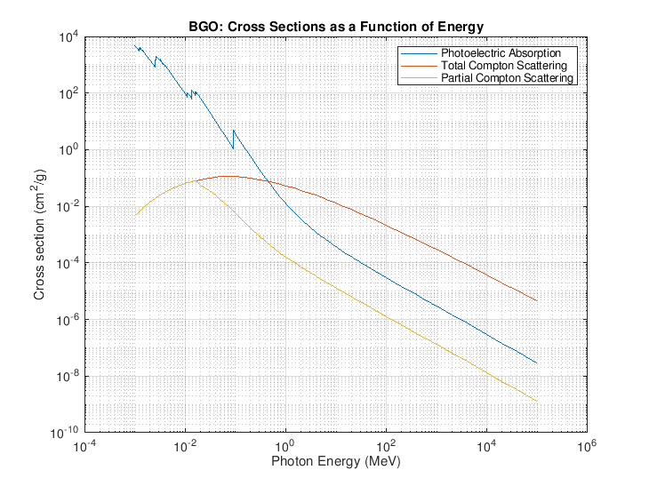
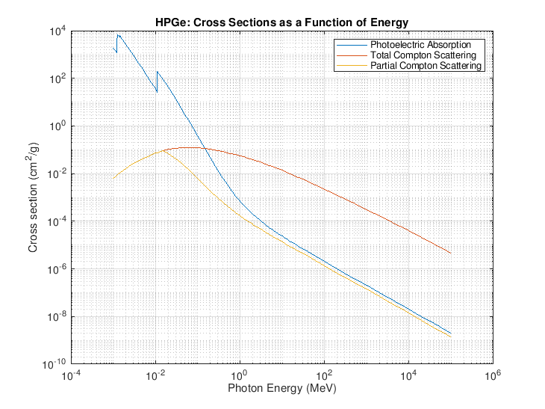
BGO and HPGe Cross Sections
HEPH-Hassard-2
22/03/2018
*Partial Compton scattering cross sections: secondary electrons with an energy within 1keV from the Compton Edge
28

Slide 29
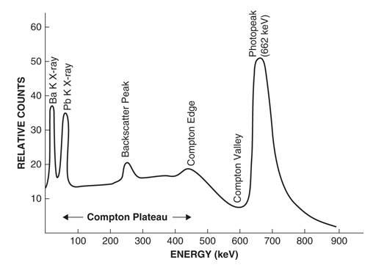
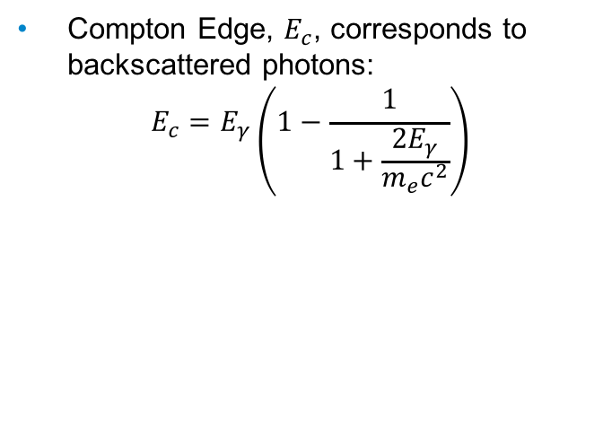
General Features of Gamma Spectra
HEPH-Hassard-2
22/03/2018
Compton Edge, $E_{c}$, corresponds to backscattered photons:
$$E_{c}=E_{γ}\left(1−\frac{1}{1+\frac{2E_{γ}}{m_{e}c^{2}}}\right)$$
29

Slide 30
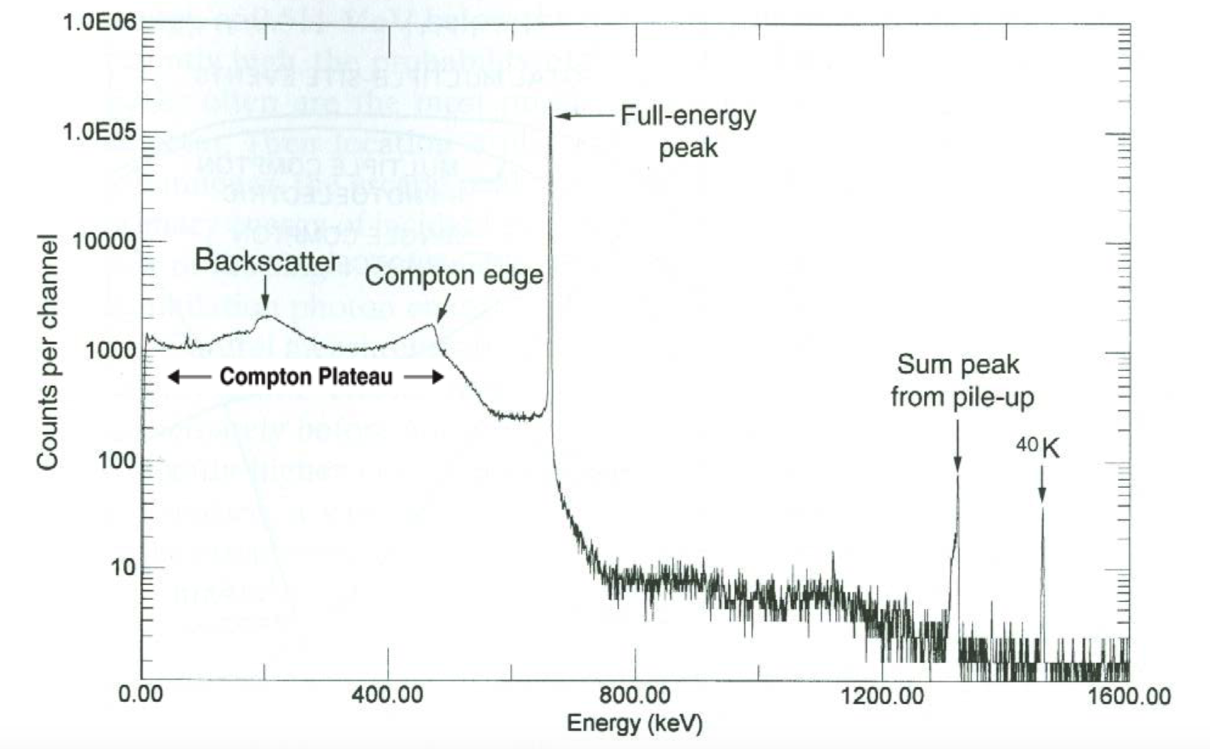
HPGe Gamma Spectrum
HEPH-Hassard-2
22/03/2018
30

Slide 31
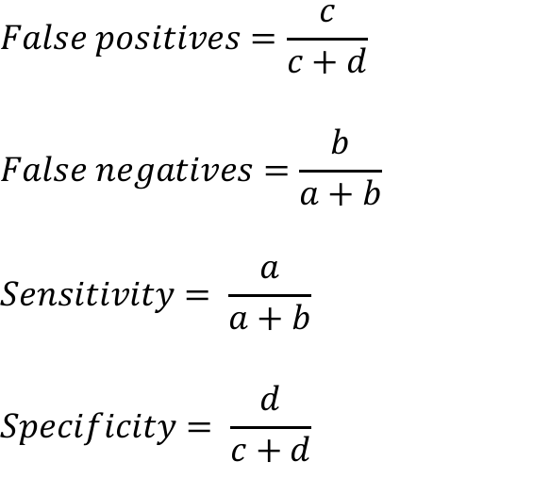
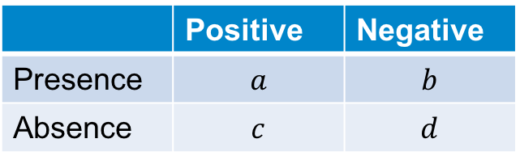
Definitions of Detection Rates:
HEPH-Hassard-2
22/03/2018
$$False positives=\frac{c}{c+d}$$
$$False negatives=\frac{b}{a+b}$$
$$Sensitivity= \frac{a}{a+b}$$
$$Specificity= \frac{d}{c+d}$$
 | Positive | Negative
Presence | $$a$$ | $$b$$
Absence | $$c$$ | $$d$$
31

Slide 32
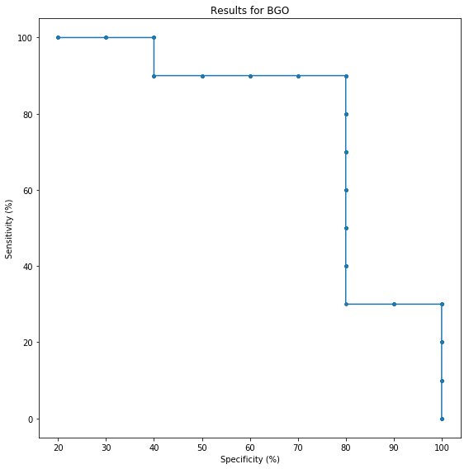
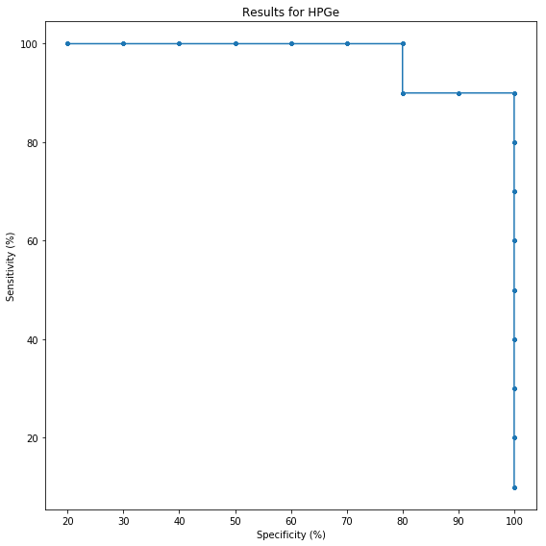
HEPH-Hassard-2
22/03/2018
32

